Slide 1
LIBRARY MANAGEMENT SYSTEM USING TKINTER
Submitted By
GEETHU

Slide 2


Slide 3
Objective
Library Management System using Tkinter Project is a solid GUI-based python project with the help of database.
It’s a result of concatenation of Python supporting GUI library Tkinter and mysql database.
This project is useful to implement the key functions used for Library management in a GUI.

Slide 4



Prerequisite

Slide 5
Tkinter
Tkinter is the python binding to the Tk GUI toolkit. It is a standard Python interface to the GUI toolkit. Tkinter is a free software released under a python License.It is portable across all operating systems. It consist of layered design
MYSQL Connector
It is a self contained Python driver for Communicating with MYSQL servers, and how to use it to develop database applications.

Slide 6
Tkinter Widgets
Frame
LabelFrame
Text
Scrollbar
Combobox
Listbox
Button
Cursor
Treeview

Slide 7
Features
DASHBOARD- It will include the details of member and book. It is designed to enable main functions with buttons.It shows the database too. Functions are,
Add Data
Show Data
Update
Reset
Delete
Exit

Slide 8
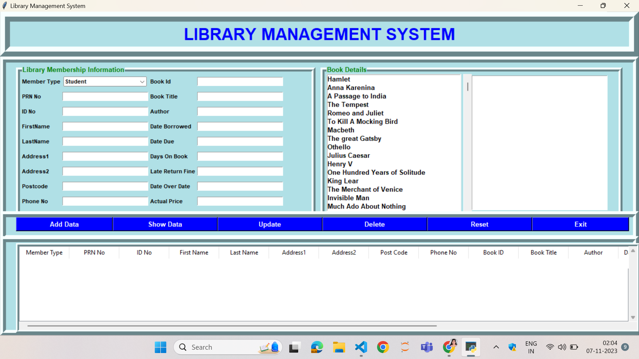
End Result

